Slide 1
Eastern Wake Business Alliance Kick Off
Career & Technical Education
WCPSS Career Development
Barnanne Creech (ZGTMMS) & Katie Coble (EWHS)

Slide 2
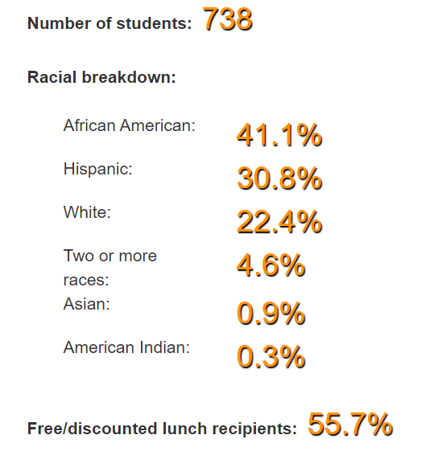
Zebulon Middle Facts

Slide 3
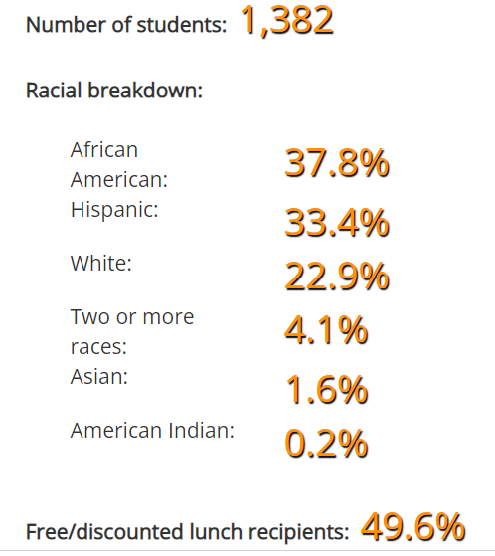
East Wake High Facts

Slide 4
A day in the life of a middle schooler (6th, 7th & 8th)
A day & B day
attending core classes every day - ELA, Math, Science & Social Studies
Attending 2 electives on A day and 2 electives on B day = 4 electives each 9 weeks
5 periods a day (each period 65 minutes)
Athletics for 7th & 8th graders
Wide variety of after school clubs

Slide 5
ZGTMMS School Improvement Plan
Vision & Mission
Zebulon Gifted & Talented Magnet Middle school is a safe and collaborative environment that nurtures the unique gifts and talents and fosters student achievement and growth. ZGTMMS will prepare all students to be competitive in the 21st century by broadening the focus beyond core subjects to include life and thinking skills, current technology and global, civic, and health awareness.
Core Values
Establish meaningful relationships and collaborative classroom communities
Provide rigorous and relevant core and elective curriculums that nurture each student’s gifts and talents.
Emphasize individualized student growth and provide necessary support

Slide 6
What is a Business Alliance ?
Your business can join others, civic organizations, and higher-education institutions in providing relevant, realistic experiences that help students see the connection between academic success today and career success tomorrow. The Wake County School-to-Career program is supported by a volunteer council and aligned with our Career-Technical Education curriculum.
Middle and high school-based business alliances are partnerships between business leaders and educators to help every student make responsible, productive career choices by assisting with activities at school and in the workplace. Business Alliances get involved with career fairs, practice job interviews, discussions about business ethics, field trips, site tours, internships, guest speaking and resumé reviews to mention a few.
WCPSS Regional BA Chairs - see handout
School to Career Volunteer Superintendent’s Breakfast Oct 2022

Slide 7
What is Career & Technical Education?
Our Career and Technical Education (CTE) program aims to prepare students for employment opportunities, advanced education and productive lives.
CTE promotes best practices that enhance teachers' efforts to improve student achievement and encourage responsible career choices. We want to meet students' needs, cultivate their abilities and help them realize their aspirations.
Middle school students are offered exploratory courses in business and information technologies, life skills, technology systems and career decisions.
In high schools, introductory courses are available at grades 9 and 10, with advanced and specialized instruction in 11 and 12. We have agriculture, business and information technology, career development, health occupations, family and consumer sciences, marketing, technology, and trade and industry.

Slide 8
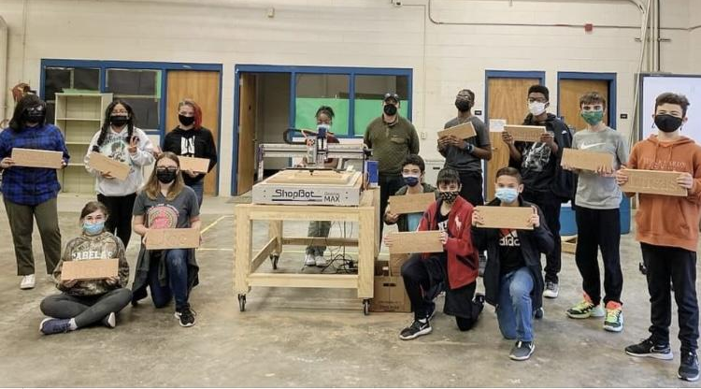
CTE = Real World Skills in a Classroom

Slide 9
What is a Career Development Coordinator?
Each middle school has a 50% Career Development Coordinator to support the school-to-career connection and facilitate business alliance activities.
Each high school has a 100% Career Development Coordinator to support students and find internships and job-shadowing opportunities. Special Populations Coordinators provide support services for qualifying students. Dual enrollment and advanced placement opportunities are available at local community colleges.

Slide 11
ZGTMMS Career Development Programming
All students take a Career Survey @ ZGTMMS
All WCPSS 8th - 12th grade have access to Major Clarity for career surveys
Students taught about the 16 career clusters
Students choose CTE courses based on career cluster interest
Activities/Events are lined up based on students results of their career survey
*Virtual & In person Guest Speakers
*Off Site Learning Experiences
*Job Shadow Experiences
*After School Clubs
*Virtual & In Person Truck Fairs
*Virtual & In Person College & Career Fairs

Slide 12
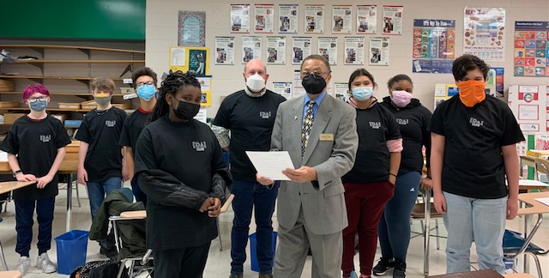
CTE Month Proclamation Signing

Slide 13
Course Planning for Students
Based on Career Cluster interest help students line up CTE courses for 6th -12th grade… as WCPSS have so many options…
* 6 Early Colleges
* Magnet High Schools
* Base High School Career Academies
EWHS Academy of Life Science
1st Annual Eastern Wake Early College
& Magnet Info Session - Tue Nov. 1 6-7:30pm

Slide 14
ZGTMMS Plans for 2022-23
Magnet School Electives - Guest Speakers in ALL 5th period magnet electives
After School Club help - Diversity Architecture & Science Olympiad
Truck Fair – Thur. Nov. 10 (9-12:30pm) See here!
College/Career/Military Fair Tue. May 9 (9-12:30pm)
Junior Achievement Events Dec. 5 or Dec. 21 & March 24
OSLE 8th grade – 3 CC per month Jan-May & 1 CC June
College visits – 1 per month Jan-May
Financial Event (SECU) June TBA

Slide 15
EWHS Plans for 2022-23
Youth Caucus Nov 16
ASVAB Nov. 22
Mock Interviews Dec 8th (will need volunteers TBA-1 hr)
Career Fair Thur. Feb 23 (will need participants 8am-1pm)
Need job shadow opportunities
Need internships/apprenticeship opportunities for students

Slide 16
How can you help students be
college & career ready?
Be an active member of our Eastern Wake Business Alliance
Share your contacts with Barnanne & Katie
Offer to guest speak about your career either virtually or in person
Open your business for a virtual or in person tour
Offer your skills to career mentor a student or a student group
Sponsor/mock judge a student CTSO project for their competitions
Donate pens, pencils, notebooks, swag from your business (Nov & Feb events)

Slide 17
Share Contacts with Us!
We are a team, and together everyone achieves more !
So.. It’s your time to share….
We need You !
See link here !
Type in https://tinyurl.com/3bv9zeyr

Slide 18
Next Steps
· Next EWBA Meetings
*Tue. Dec. 20 EWHS 12-1pm
*Thur. Feb.9 ZGTMMS 4-5pm
Zebulon Chamber After Hours 5-7pm
*Thur. April 13 EWHS 12 -1 pm

